Slide 1
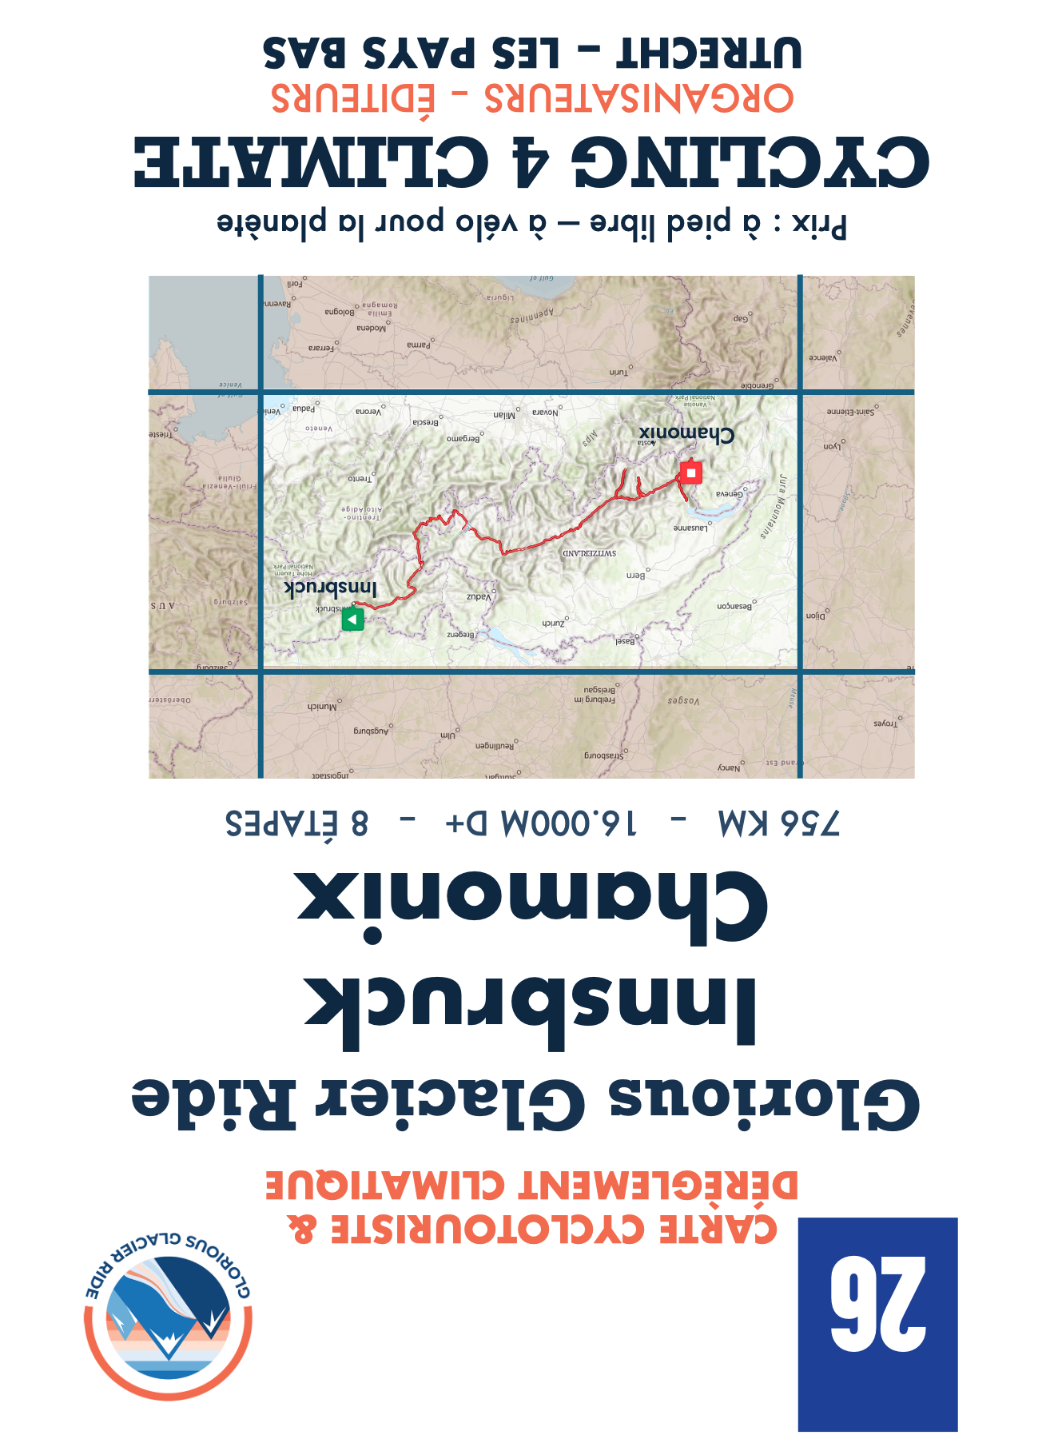
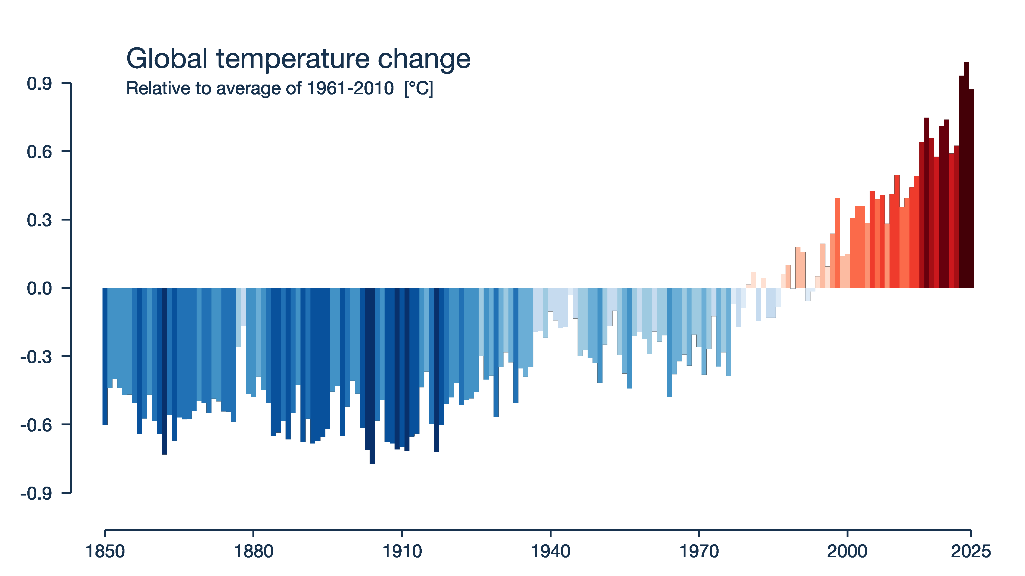
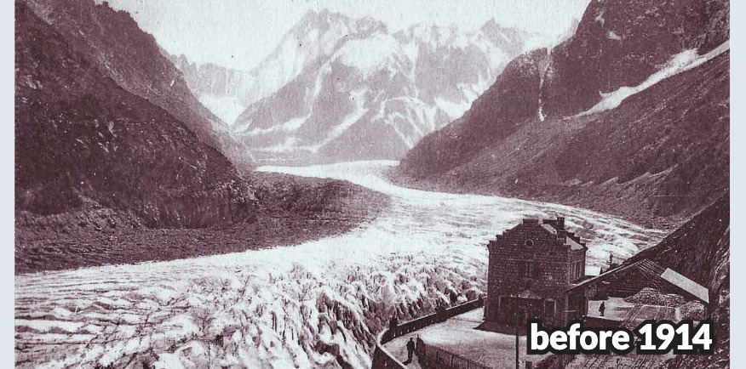
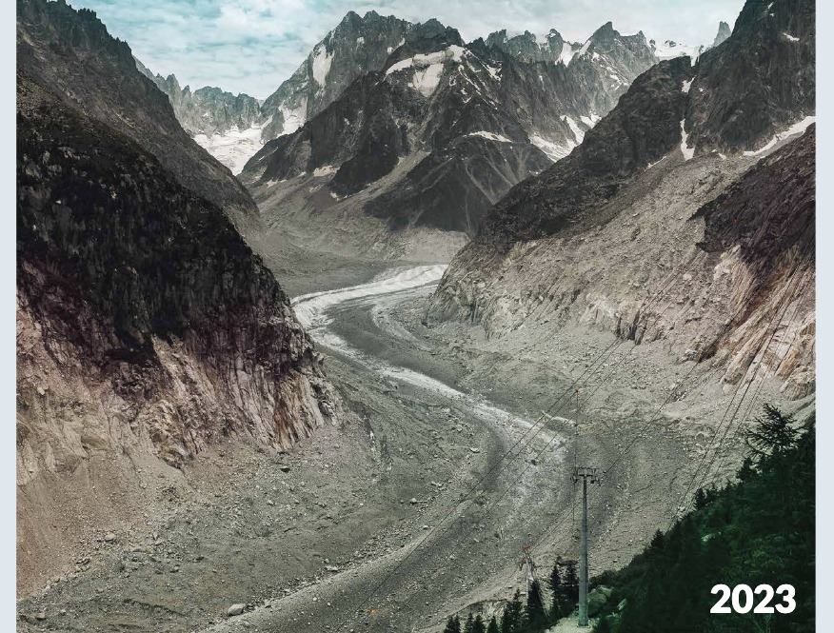

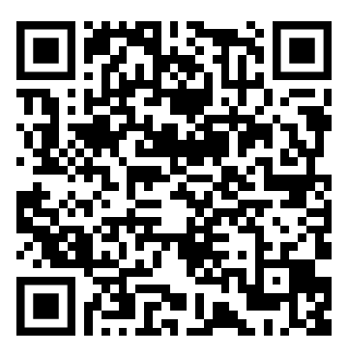
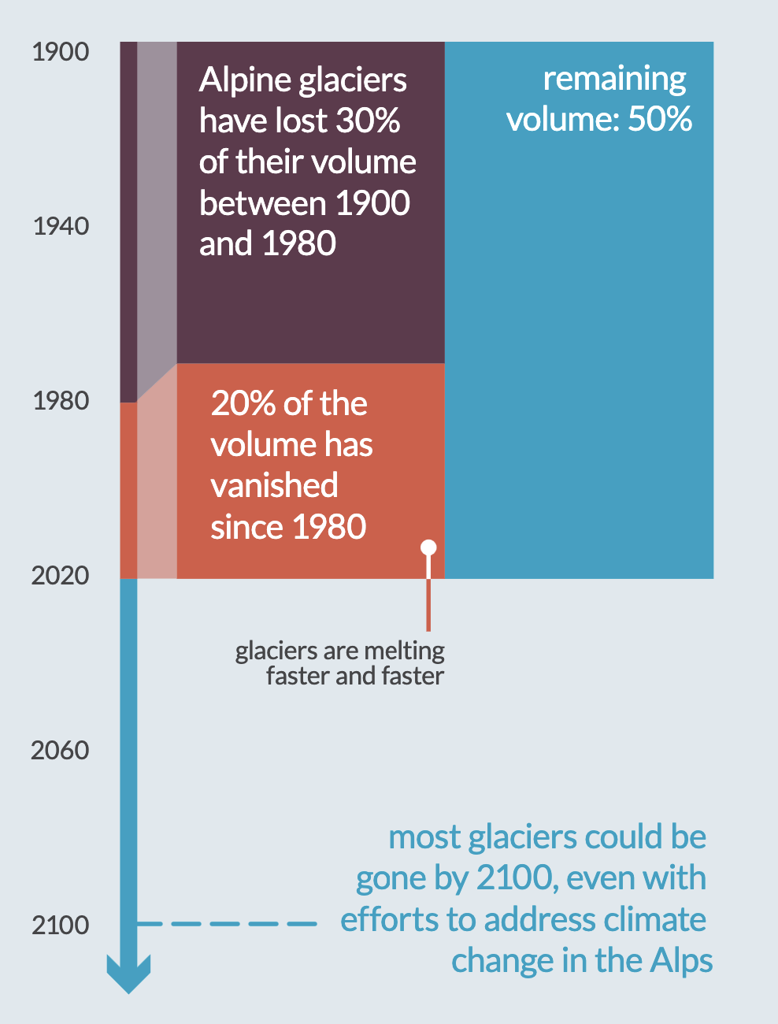
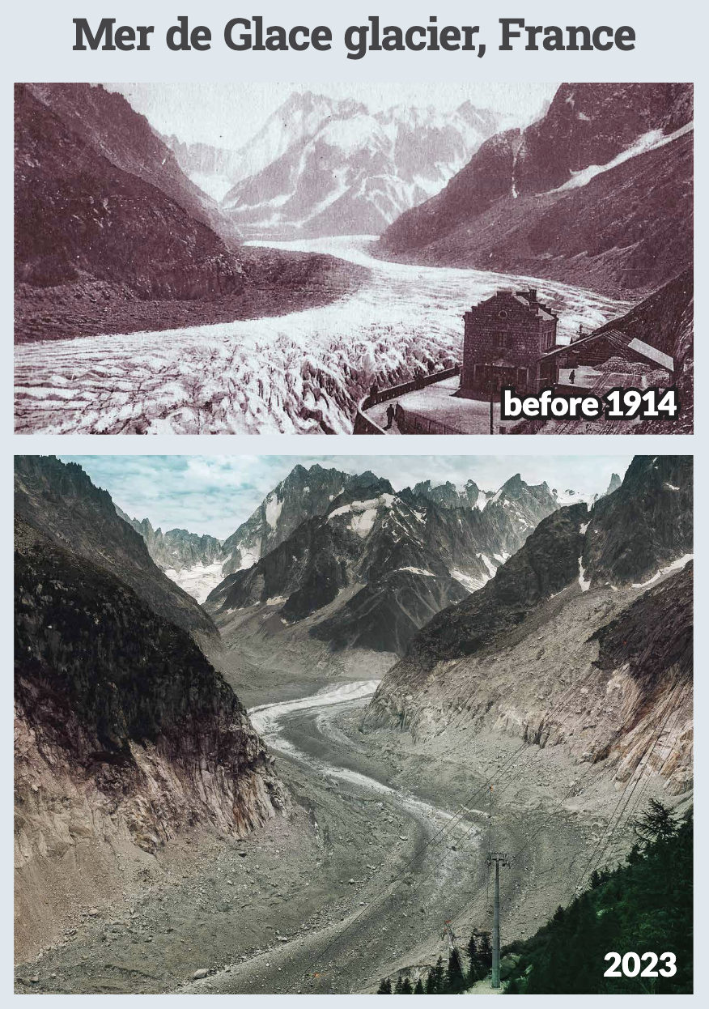
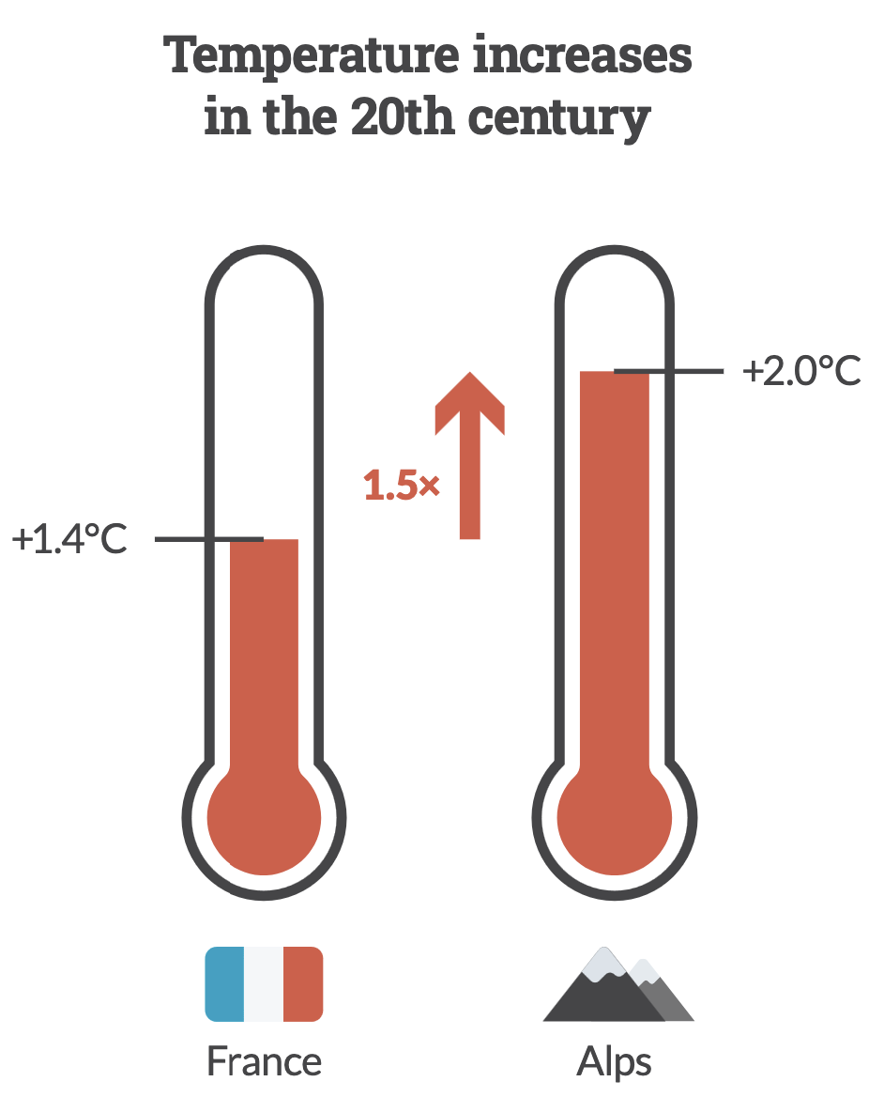
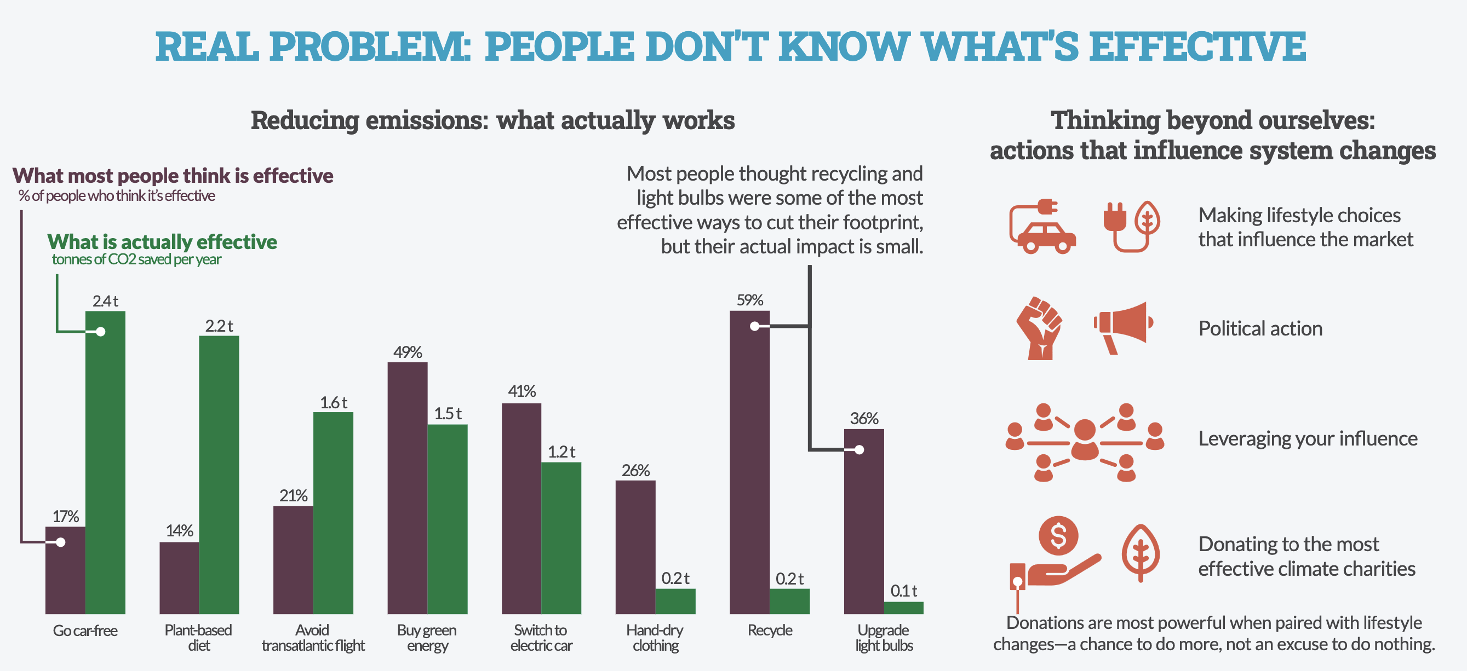
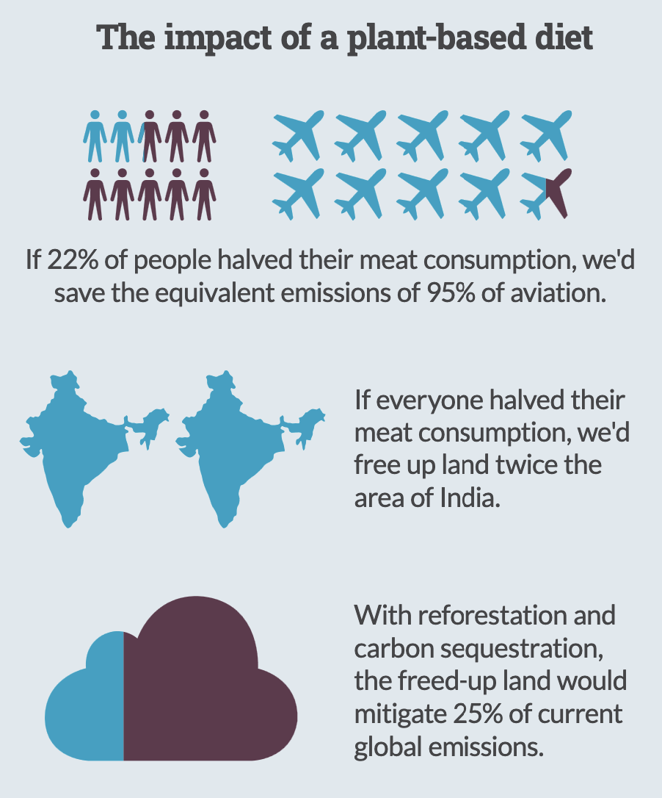
Our climate is changing.
Faster than we think.
Europe is the fastest warming continent.
This affects the Alps.
The challenge is bigger than the Alps. It’s about our only home.
Temperature increases
in the 20th century
Alpine glaciers:
volume lost
Mer de Glace glacier, France
+2.0°C
1900
+1.4°C
−30%
by 1980
1.4x
1980
−20%
since 1980
2020
50%
remains
France
Alps
2100
Most could be
gone by 2100
Real problem: People don’t know what’s effective
Reducing emissions: what actually works
Thinking beyond ourselves:
actions that influence system change
What people think is effective (%)
Making lifestyle choices
that influence the market
What's actually effective (t CO₂ saved/yr)
26
2.4t
2.2t
59%
49%
41%
Political action
1.6t
1.5t
36%
21%
1.2t
26%
Leveraging your influence
While we cycle the
Glorious Glacier Ride,
You can support us and clean up your emissions!
THANK YOU FOR YOUR LEADERSHIP!
17%
14%
Donating to the most
effective climate charities
0.2t
0.2t
0.1t
Go car-free
Plant-based diet
Avoid transatlantic flight
Buy green energy
Switch to electric car
Hand-dry clothing
Recycle
Upgrade light bulbs
Donations are most powerful when paired with lifestyle changes — a chance to do more, not an excuse to do nothing.
Most people overrate recycling and light bulbs — and underrate cutting flights and driving.
The impact of a plant-based diet
22%
of people halving their meat consumption would save the equivalent of 95% of aviation's emissions.
2×
the area of India in farmland would be freed up if everyone halved their meat consumption.
Did you ever think of cleaning up your own emissions?
25%
of current global emissions could be mitigated by reforesting that freed-up land.

Slide 2


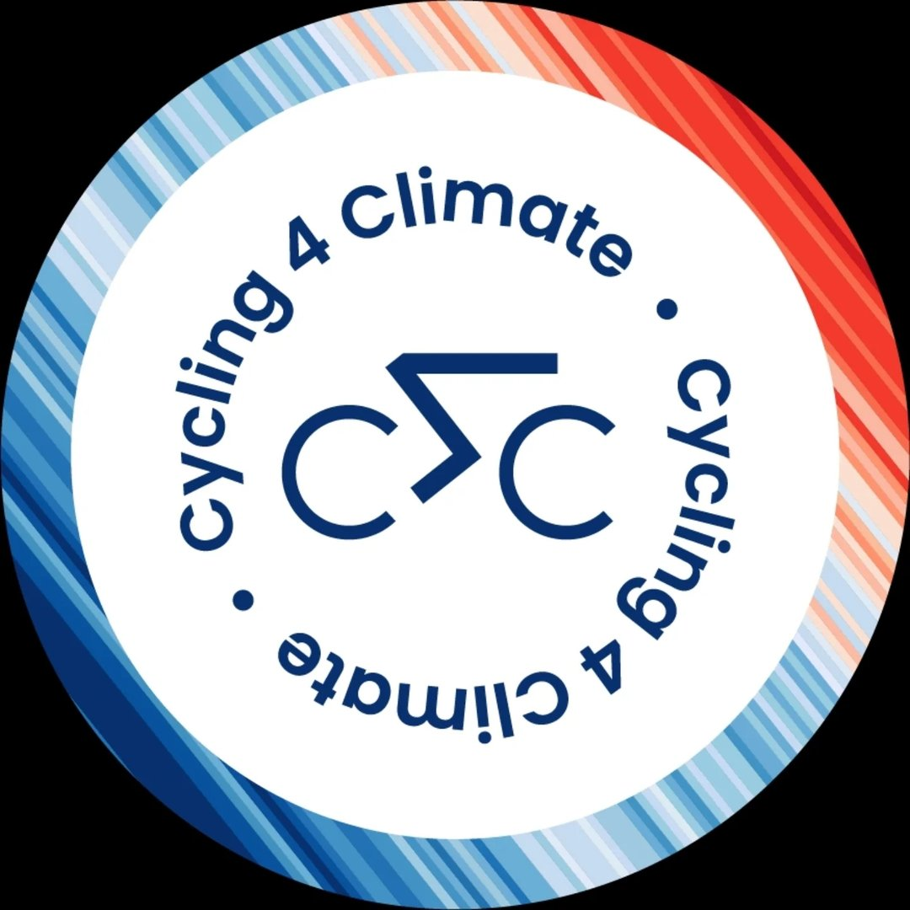
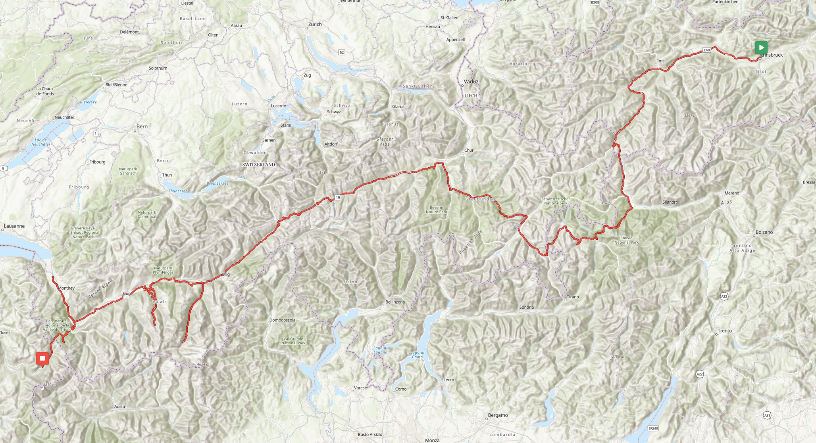
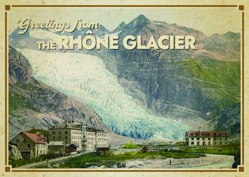


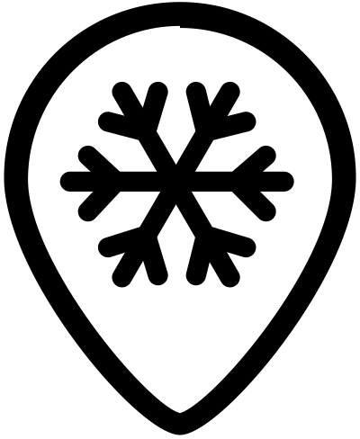
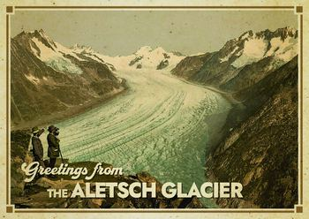
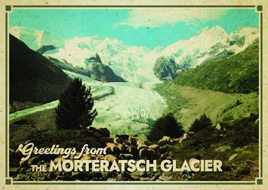
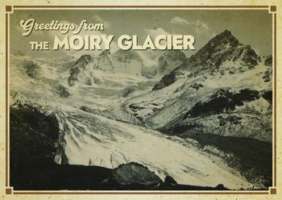
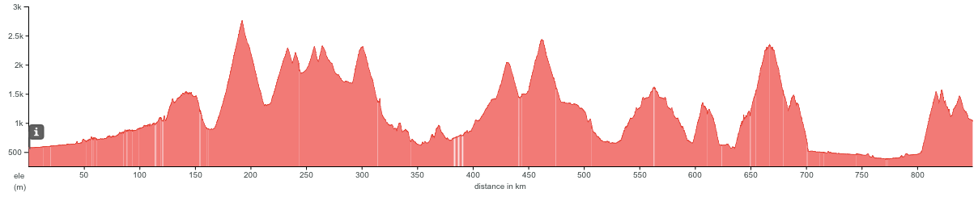
Innsbruck
August 28
Chamonix
September 4
Edition 2026 - 8 days
756 km - 16.000 m D+
Innsbruck
Retreated almost 1 km
over the last 20 years
Nauders
Reschenpass
Oberalppass
Thusis
Rhône
Albulapass
Lost 4.6m of ice thickness
in 2024 alone
Andermatt
Lost ⅔ of its volume
since 1900
Livigno
Passo dello Stelvio
Furkapass
Aletsch
Passo di Foscagno
Morteratsch
Passo del Bernina
Aigle
Unterbäch
One of Switzerland's many
small glaciers — under 5 km²
Col des
Montets
Col de la Forclaz
Zermatt
Trient
Moiry
Gorner
Mer de Glace
Chamonix
Mont-Blanc
Foscagno
Date | Start | Finish | Distance | Elevation
28 Aug | Innsbruck | Nauders | 131 | 2000
29 Aug | Nauders | Livigno | 118 | 3400
30 Aug | Livigno | Thusis | 110 | 2000
31 Aug | Thusis | Andermatt | 101 | 2500
Date | Start | Finish | Distance | Elevation
1 Sep | Andermatt | Unterbäch | 105 | 2100
2 Sep | Restday
3 Sep | Unterbäch | Aigle - UCI | 96 | 2500
4 Sep | Aigle - UCI | Chamonix | 95 | 1990
Reschen
Stelvio
Bernina
Oberalp
Albula
Furka
Moiry
Unterbach
Montets
Zermatt
Forclaz

